Slide 1

DataFlow Nexus
Turning Sales Data into Smart Strategies

Slide 2
Abstract
Overall, the DataFlow Nexus represents a strategic approach to data management, focusing on the seamless, secure, and efficient flow of data across an organization's digital landscape.
Some key features include:
1. Scalability: It can handle vast amounts of data, scaling horizontally across multiple nodes to accommodate growing data volumes.
2. Real-Time Processing: The framework supports real-time data ingestion and processing, allowing organizations to make decisions based on the most current data available.
3. Data Integration: It connects diverse data sources, ensuring that data is in sync across the organization.
4. Security and Compliance: The DataFlow Nexus is designed with robust security protocols to protect data integrity and ensure compliance with regulatory requirements.

Slide 3
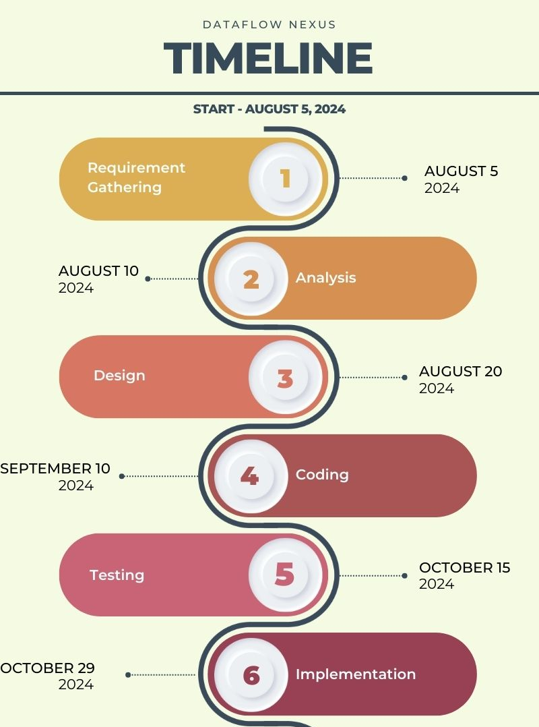

Slide 4
Existing System Disadvantages
and Proposed System Advantages
Existing Software | Disadvantages (Cons) | DataFlow Nexus Advantages
HubSpot Sales Hub | - Challenging navigation due to too many features - Limited email sequence capacity | - Streamlined interface with customizable feature access - Unlimited email sequences to enhance campaign flexibility
Active Campaign | - Less intuitive user experience - Report generation can be challenging | - User-friendly and intuitive UI for easy onboarding - Simplified and advanced report generation with customizable options
Salesforce Sales Cloud | - Slow interface loading - Inadequate in-depth engagement metrics in sales automation | - Optimized for fast loading times - Comprehensive sales automation with detailed engagement analytics

Slide 5
Existing System Disadvantages
and Proposed System Advantages
Existing Software | Disadvantages (Cons) | DataFlow Nexus Advantages
Gong | - Limited integrations - Slow call processing | - Extensive integration capabilities with major platforms - Efficient call processing for quick access and analysis
Engage Bay | - Limited email templates - Needs more native integrations | - Extensive library of customizable email templates - Seamless native integrations with popular tools
Chorus.ai | - Difficult access to recorded calls - Unreliable integration with Zoom and Gmail | - Easy and quick access to all recorded calls - Robust and reliable integration with Zoom, Gmail, and other platforms

Slide 6
Existing Software | Disadvantages (Cons) | DataFlow Nexus Advantages
Cube19 | - Lack of pipeline forecasting - UI/UX interface needs improvement | - Advanced pipeline forecasting feature - Modern and user-friendly UI/UX for better user engagement
Groove | - Limited CRM capabilities - Task sharing challenges | - Full-featured CRM with advanced capabilities - Seamless task sharing with collaborative tools
Quota Path | - Limited customization - Slow interface loading | - High degree of customization to meet diverse needs - Fast and responsive interface for better user experience
Zoho | - Time-consuming data import and sync - Weak social media integration | - Quick and easy data import/sync with real-time updates - Enhanced social media integration for better lead management

Slide 7

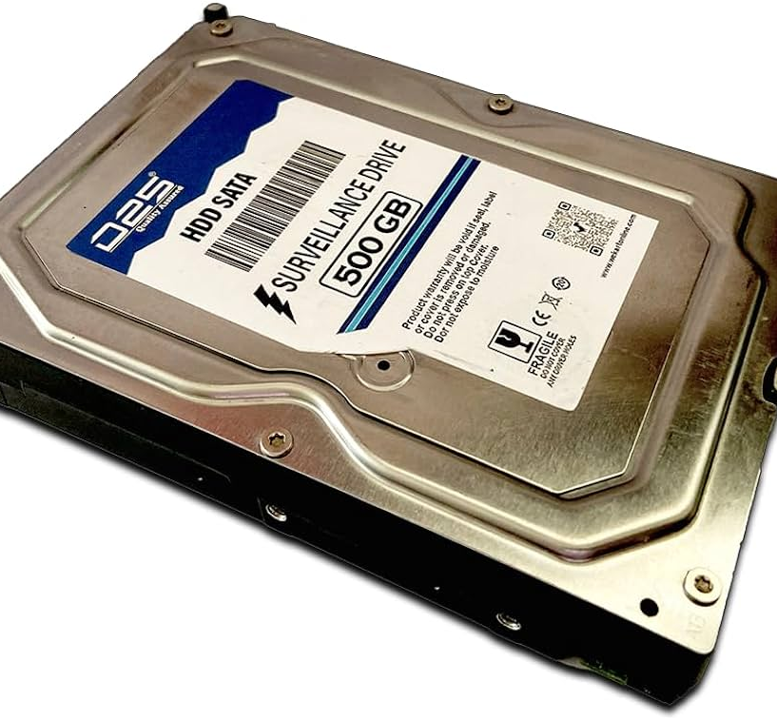

Hardware Requirements
A computer with at least 4 GB ram,
Intel Core i5 processor or higher,
500 GB hard drive (HDD or SSD)

Slide 8
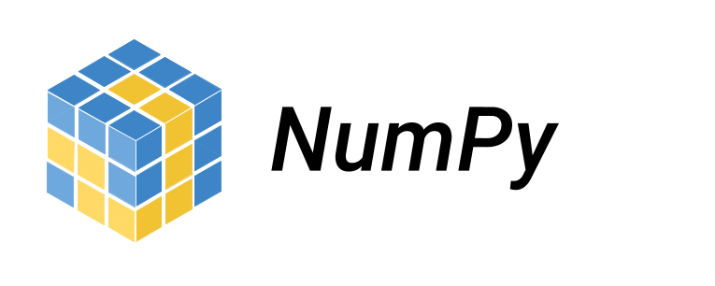



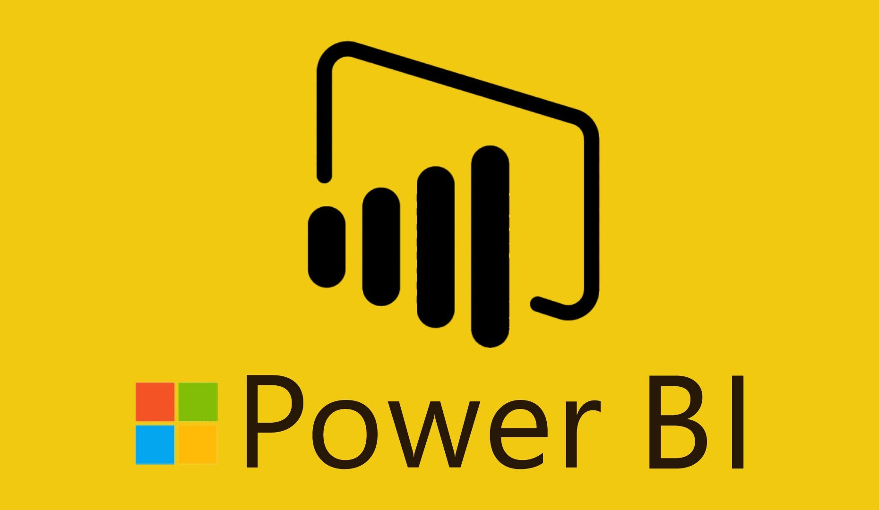




Software Requirements
Operating system (Windows 10 or higher)
Business Intelligence tools and libraries works such as NumPy, Pandas, Seaborn, Matplotlib, MS-Excel, MS-Power BI, Jupyter Notebook and Python are used to build the whole framework

Slide 9
Introduction
[Start]
Data Collection
Data Cleaning and Preprocessing
Our DataFlow Nexus product is designed to revolutionize the way businesses analyze and interpret their sales data.
By using advanced data analysis techniques and tools, we provide deeper insights and more accurate predictions than traditional methods.
Our product is not only powerful but also user-friendly, ensuring that businesses of all sizes can benefit from its capabilities.
With features like real-time analysis, advanced visualization, and predictive analytics, our product stands out in the market.
Whether you’re a small business looking to optimize your sales strategy or a large enterprise seeking to gain a competitive edge, our is the perfect solution for your needs.
Data Analysis using Python (NumPy, Pandas)
Visualization using Seaborn, Matplotlib, and Power BI
Insight Generation
Recommendations for Strategy and Automation Implementation
[End]

Slide 10
DataFlow Nexus: Your Data Solution
Enhanced accuracy – by using advanced data cleaning and preprocessing techniques.
Real-Time Analysis – allows to make timely decisions.
Advanced Visualisation – by using tools like Matplotlib and seaborn to make clear visual representation of the data.
Scalability – it is designed to handle large datasets efficiently, making it suitable for businesses of all sizes.
User-Friendly interface - our product ensures that even non-technical users can interact with the system and derive meaningful insights from the data.
Automated processes - our product automates many of the manual processes involved in data analysis, such as data cleaning and report generation. This saves time and reduces the risk of human error.

Slide 11
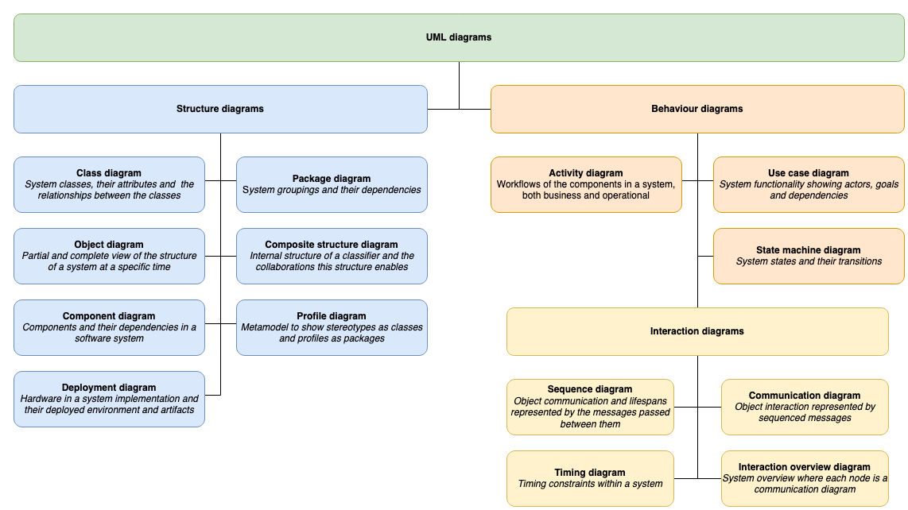
UML Diagrams

Slide 12
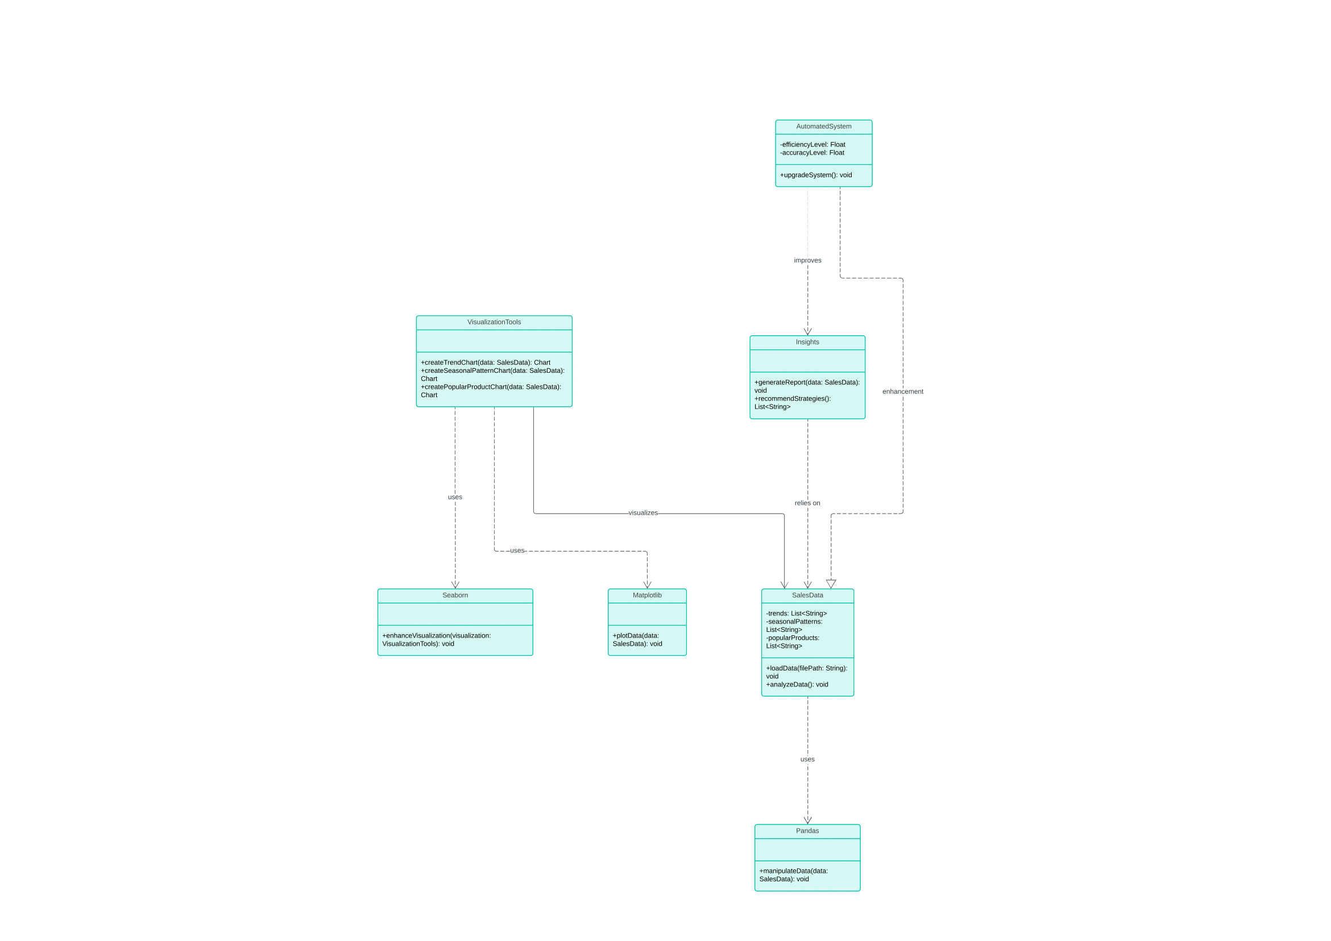
Class Diagram
Why a class diagram?
Better to visualize the structure
For guidance and development
Enhance communication
Central Role of SalesData: Emphasize that SalesData is the backbone of the system, connecting data loading, analysis, and visualization.
Pandas for Data Manipulation: Discuss how Pandas plays a crucial role in manipulating and preparing raw sales data for further analysis.
Visualization with Matplotlib and Seaborn: Show how basic visualizations are created using Matplotlib and enhanced with Seaborn for better readability and aesthetics.
Insights and Recommendations: Explain how insights are generated from the analysis of sales data and how recommendations are made based on the data.
Automation for Efficiency: Highlight the role of AutomatedSystem in improving the efficiency and accuracy of the system, making it more scalable and effective.
Modular Structure: The design is modular, with clear separation between data handling, visualization, and insights generation, making it easier to extend or modify components without affecting the entire system.
🔗link for the diagram
Notes:
Show the attributes and public, private, protected etc

Slide 13
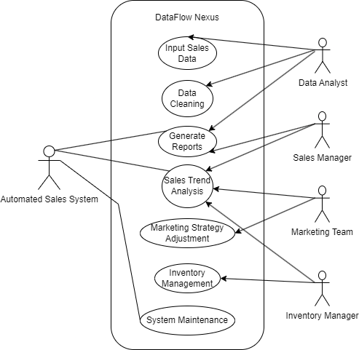
User Case Diagram
System Functionality:
This diagram highlights key functionalities, such as data cleaning, report generation, and trend analysis, emphasizing the system's role in automating sales processes.
Support for Decision-Making: Demonstrates how the system supports critical business functions like marketing strategy adjustments and inventory management based on data-driven insights.
Actor Interactions:
It shows how different users (data analysts, managers, and teams) interact with the system, helping to clarify responsibilities and workflows.
Why User Case?
Clarifies System Functions
Visualizes User Interactions
🔗 link for the diagram

Slide 14
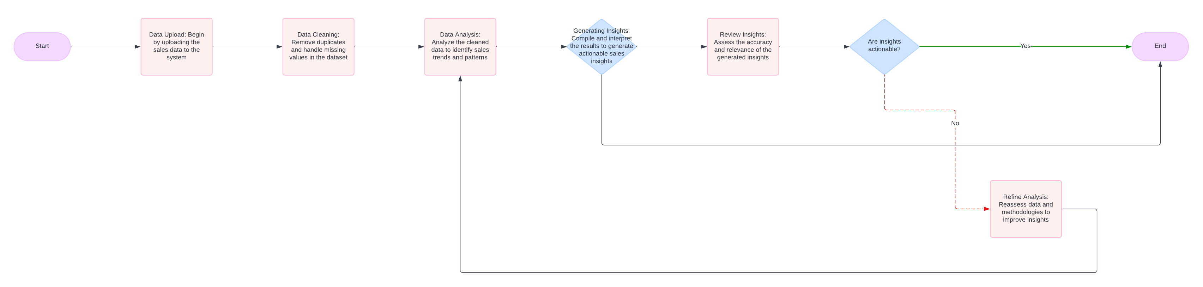
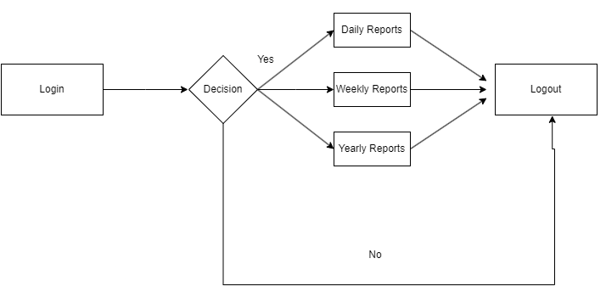
Activity Diagram
Why Activity Diagram?
Shows Sales Workflow:
It maps the process of inputting, cleaning, analyzing, and reporting sales data step by step.
Helps Automate:
Identifies what tasks can be automated, making your Automated Sales System more efficient.
Streamlines Interaction:
Reveals how users like analysts, managers, and the system interact, helping you find bottlenecks or areas for improvement.
🔗 link for the diagram

Slide 15
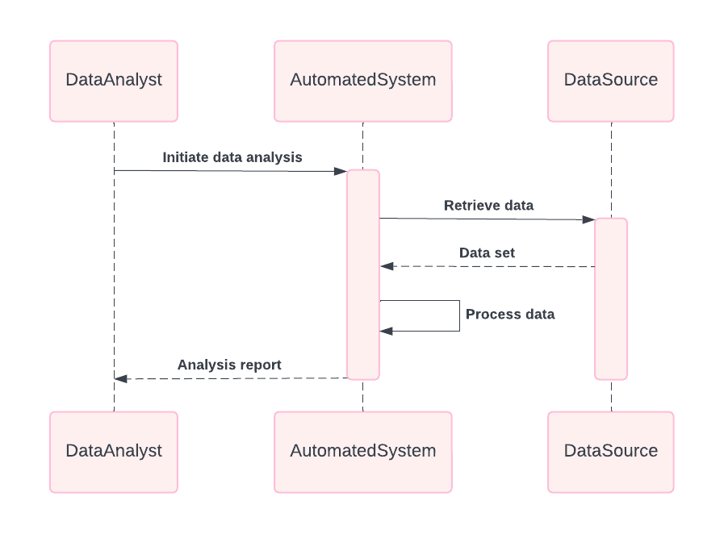
Sequence Diagram
🔗 link for the diagram

Slide 16
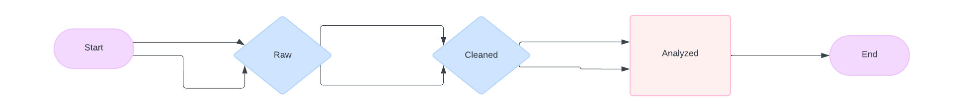
State Machine Diagram
🔗 link for the diagram

Slide 17
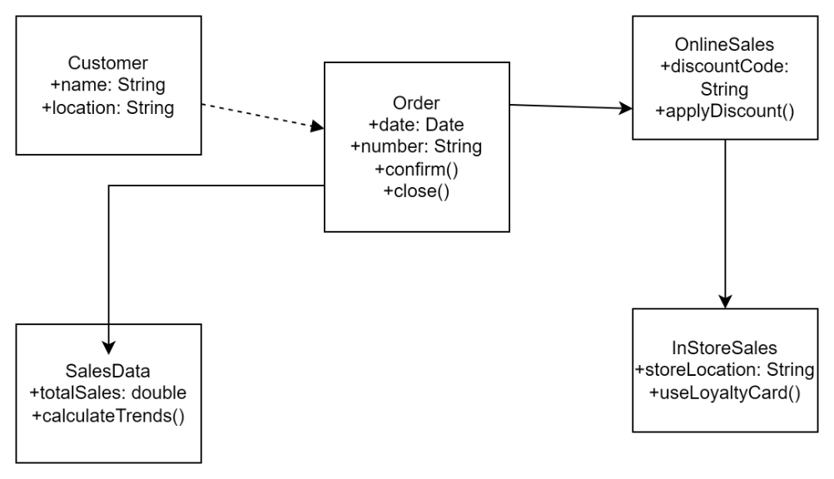
Object Diagram
Object Diagram shows real instances of objects and their relationships at a particular moment in a system.
It represents specific data or states for each object, like a customer placing an order for a product.
The diagram helps visualize how these objects interact in a particular scenario, such as sales data being processed for insights and inventory management. ​
🔗 link for the diagram

Slide 18
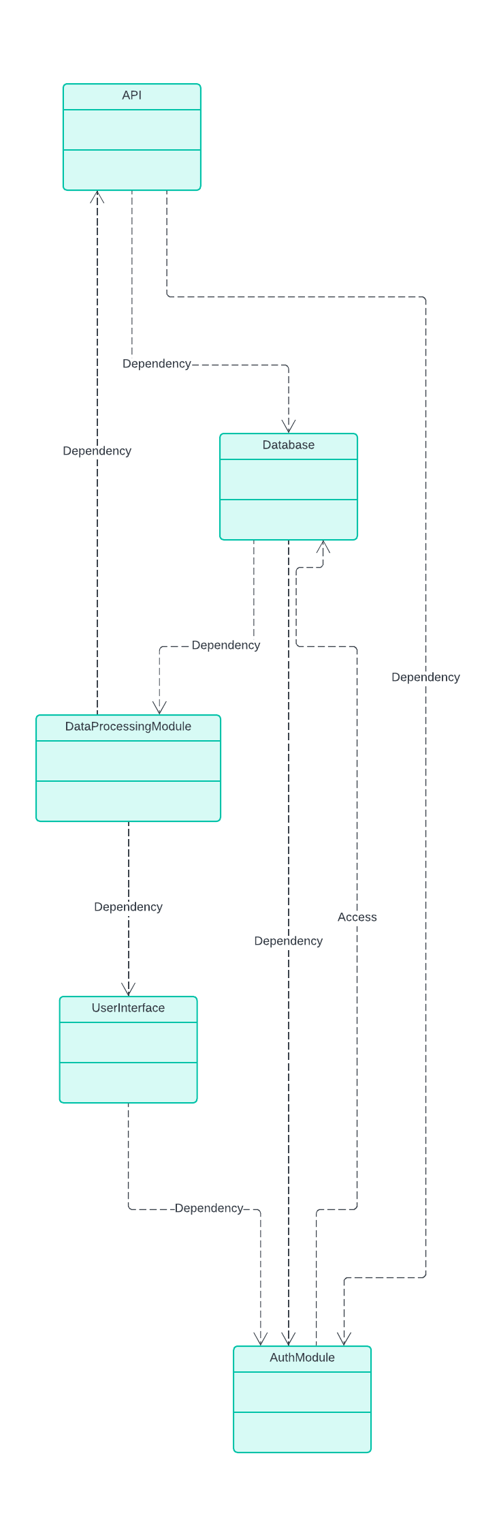
Component Diagram
A Component Diagram in UML represents the physical components of a system and how they interact or are organized.
It shows the structure of the system by depicting its software components, such as modules, libraries, and services, and how these components are connected or communicate.
Component diagrams are used to model the high-level architecture of the system, focusing on how the system is divided into parts and how those parts work together to deliver functionality.​
🔗 link for the diagram

Slide 19
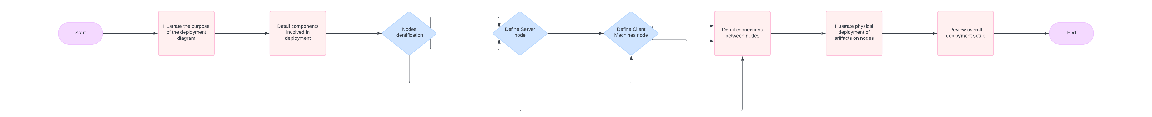
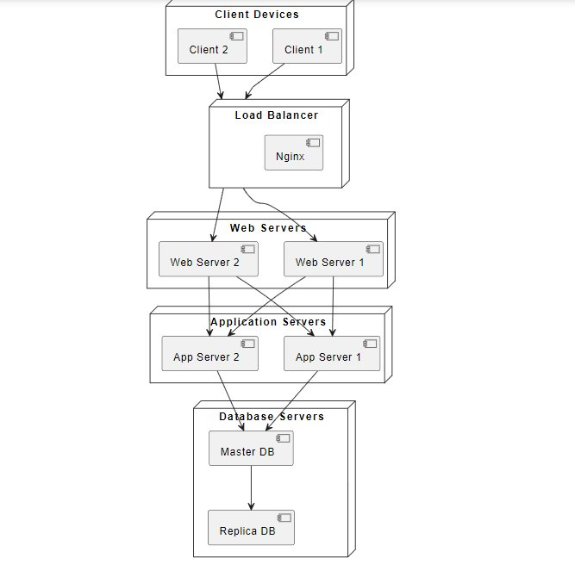
Deployment Diagram
The Deployment Diagram for the Sales Data Flow system shows how various components interact in a physical environment.
Client devices send requests through a Nginx Load Balancer, which forwards them to Apache Web Servers.
These servers process business logic via Application Servers and interact with MySQL Database Servers for data storage.
The architecture ensures efficient load balancing, data processing, and high availability.
🔗 link for the diagram

Slide 20
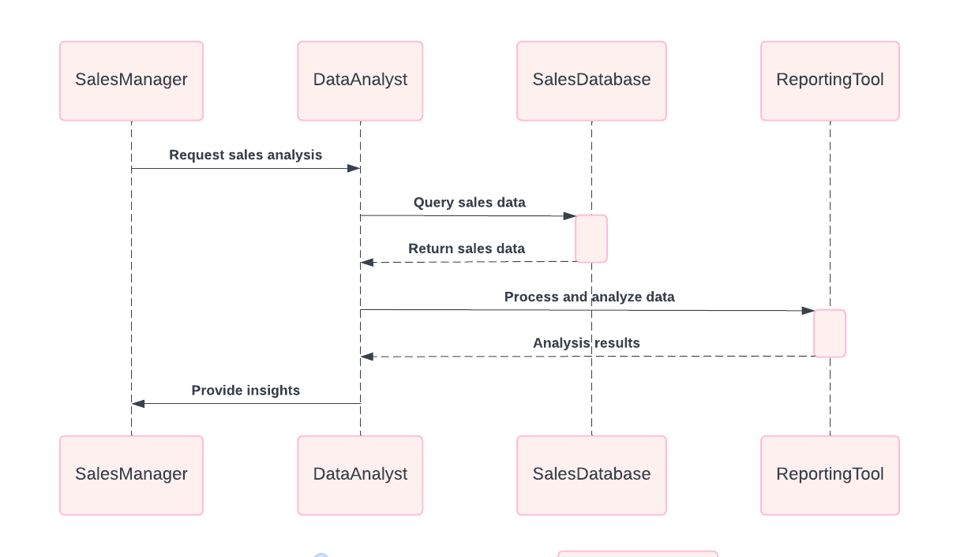
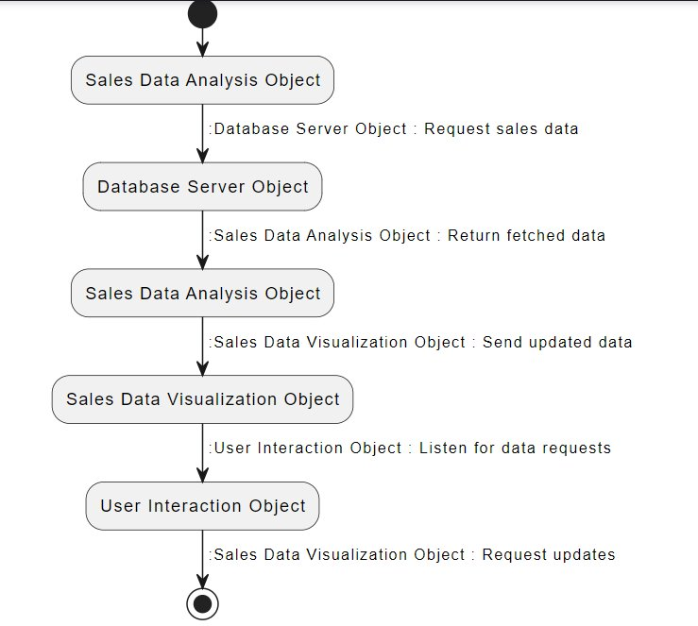
Collaboration Diagram
The Collaboration Diagram highlights how objects in the Sales Data Flow system communicate.
The Sales Data Analysis Object fetches data from the Database Server Object and sends the results to the Sales Data Visualization Object for display.
Users interact through the User Interaction Object, sending requests and receiving updates on the visualized sales data.
This diagram shows the sequential flow of data between system objects.​
🔗 link for the diagram

Slide 21
DATA FLOW DIAGRAMS
A Data Flow Diagram (DFD) visually represents how data moves through a system. It illustrates the sources and destinations of data, processes that transform it, and data storage. DFDs use standardized symbols: circles for processes, arrows for data flows, open-ended rectangles for data stores, and rectangles for external entities. They help identify data requirements, improve understanding of systems, and communicate how processes interconnect.

Slide 22
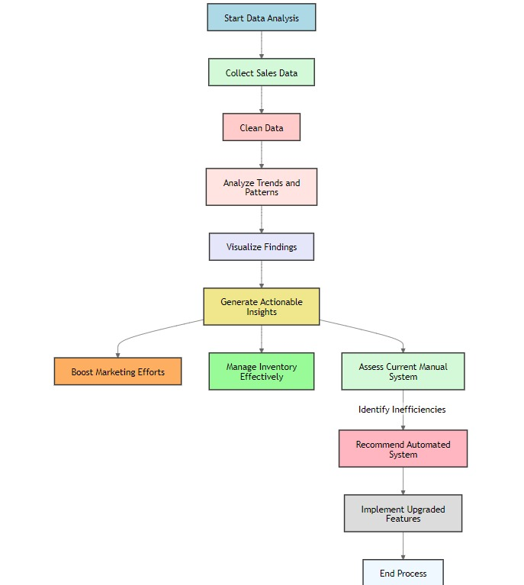
DFD LEVEL 0
A Level 0 Data Flow Diagram, also known as a context diagram, provides a high-level overview of a system. It depicts the system as a single process with its boundaries and interactions with external entities. The diagram shows data flows between the system and these entities but does not detail internal processes. This level helps stakeholders understand the system's scope and its relationship with external users or systems.

Slide 23
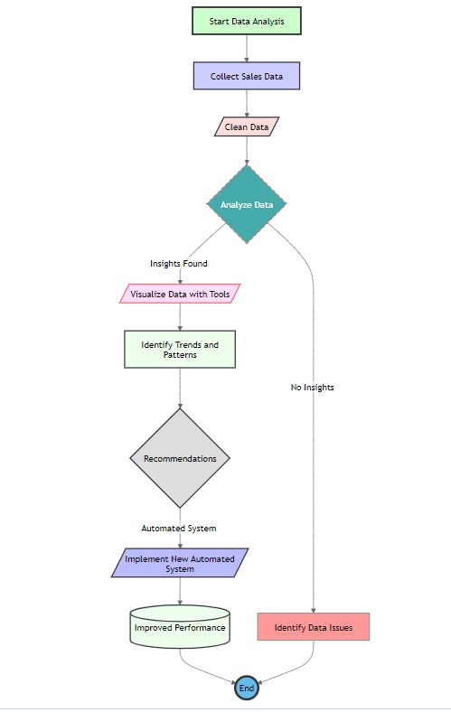
DFD LEVEL 1
A Level 1 Data Flow Diagram breaks down the main process from the Level 0 diagram into its key sub-processes It shows how data flows between these sub-processes, data stores, and external entities. This level provides more detail than Level 0, allowing for a clearer understanding of the internal workings of the system and how data is processed at each stage. It helps identify specific functions and interactions within the overall system.

Slide 24
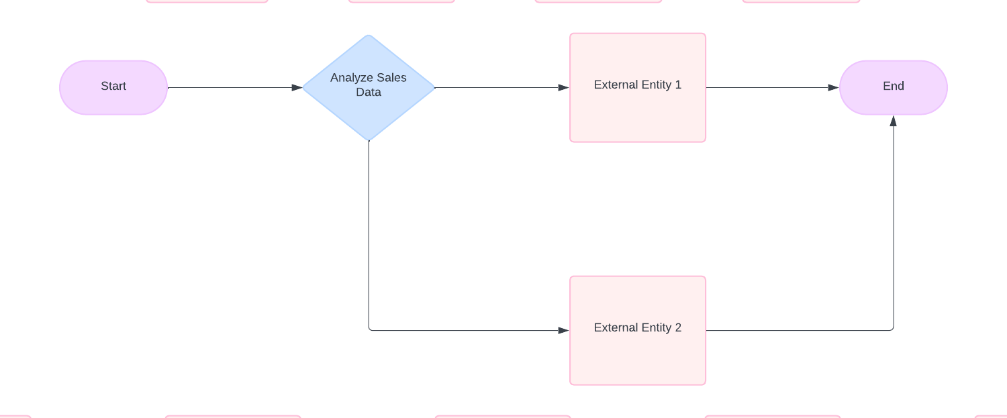
Data Flow Diagram – Level 0
🔗 link for the diagram

Slide 25
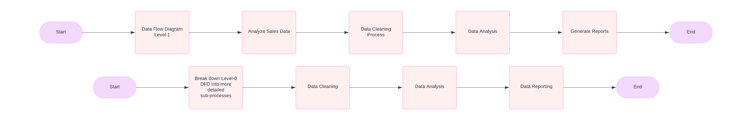
Data Flow Diagram – Level 1
🔗 link for the diagram

Slide 26
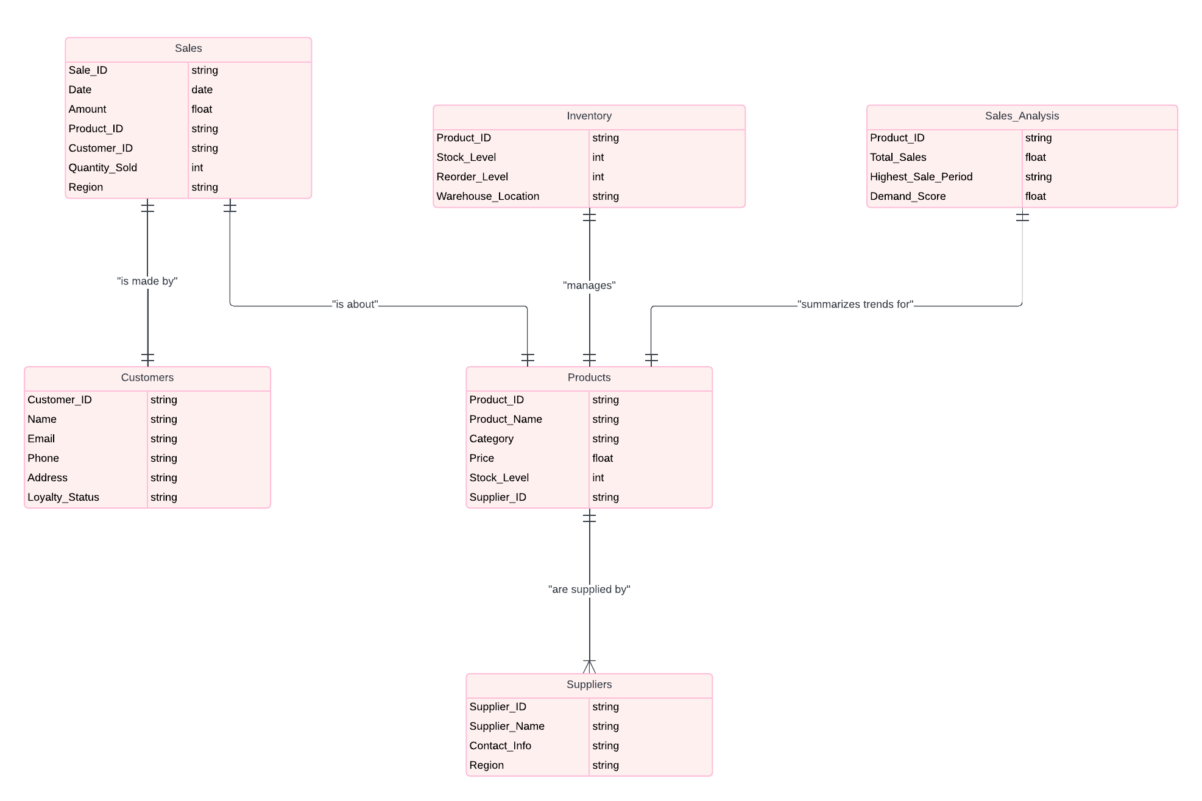
ER Diagram
🔗 link for the diagram
Notes:
Primary key, foreign key, composite and other attributes

Slide 27
Key Entities for ER Diagram (DataFlow Nexus - Sales Data Analysis):
Sales
Attributes:
Sale_ID, Date, Amount, Product_ID, Customer_ID, Quantity_Sold, Region
Tracks individual transactions.
Products
Attributes:
Product_ID, Product_Name, Category, Price, Stock_Level, Supplier_ID
Holds product catalog data.
Customers
Attributes:
Customer_ID, Name, Email, Phone, Address, Loyalty_Status
Contains customer details for analysis.
Suppliers
Attributes:
Supplier_ID, Supplier_Name, Contact_Info, Region
Stores supplier information.
Inventory
Attributes:
Product_ID, Stock_Level, Reorder_Level, Warehouse_Location
Manages product stock levels and reordering.
Sales Analysis
Attributes:
Product_ID, Total_Sales, Highest_Sale_Period, Demand_Score
Summarizes insights like sales trends and product demand
Entity Relationships:
Sales ↔ Products (via Product_ID)
Sales ↔ Customers (via Customer_ID)
Products ↔ Suppliers (via Supplier_ID)
Products ↔ Inventory (via Product_ID)
Sales Analysis ↔ Products (via Product_ID)
Why ER Diagram?
Clear Data Structure: it visually maps relationships between entities like Sales, Products, and Customers, ensuring efficient database design.
Optimized Insights: It aids in identifying sales trends and product demands
Improved System Efficiency: Supports transitioning to an automated system, enabling faster, more accurate data management and analysis.

Slide 28
Database Table Structure
This table will store individual sales transactions and reference the other tables with foreign keys.
Column Name | Data Type | Description
OrderID | INT | Primary Key (Auto Increment)
OrderDate | DATE | Date of the sale
RegionID | INT | Foreign Key referencing Region Table
ManagerID | INT | Foreign Key referencing Manager Table
SalesManID | INT | Foreign Key referencing SalesMan Table
ItemID | INT | Foreign Key referencing Item Table
Units | INT | Number of units sold
Unit_price | DECIMAL | Price per unit
Sale_amt | DECIMAL | Total sale amount
Notes:
Primary key, foreign key, composite and other attributes

Slide 29
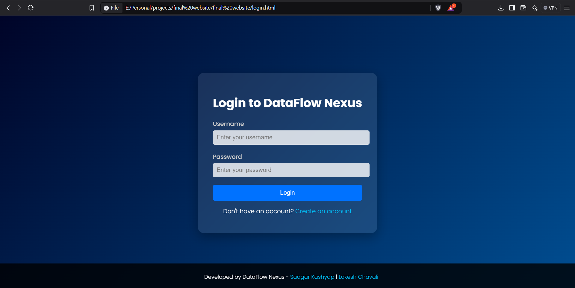
User Interface
This is the login page and one can login to our website and upload the sales data and then get instant analysis of the data

Slide 30
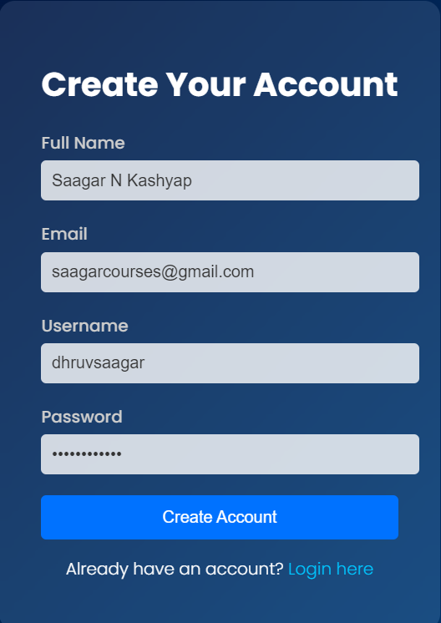
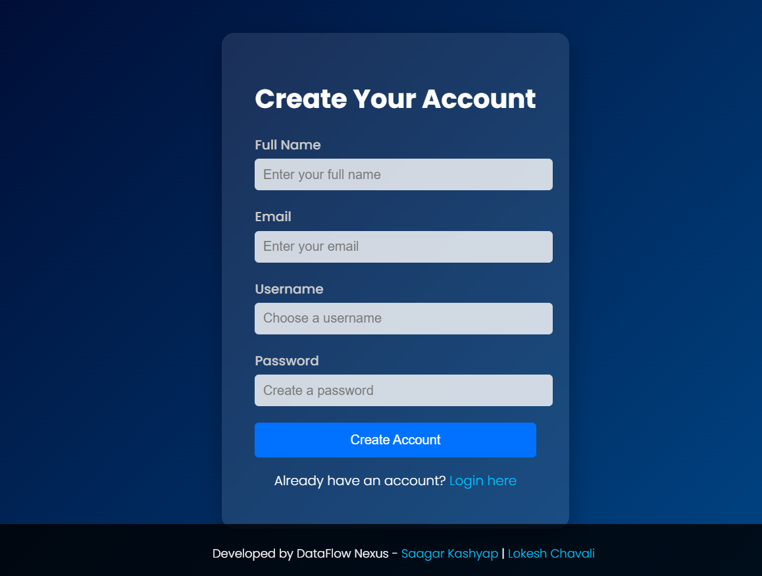
User Interface
One can also create an account and then later login too

Slide 31
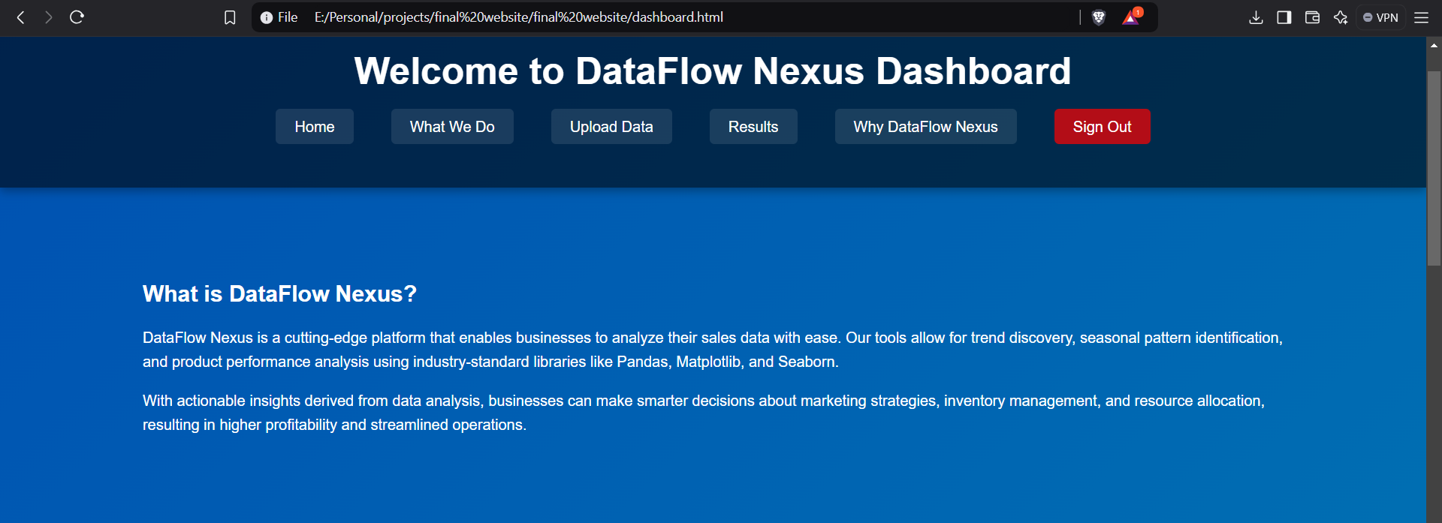
User Interface
The DataFlow Nexus Dashboard, where one can navigate between uploading data and results and meanwhile check what our company is all about – What we do and why choose DataFlow Nexus.

Slide 32
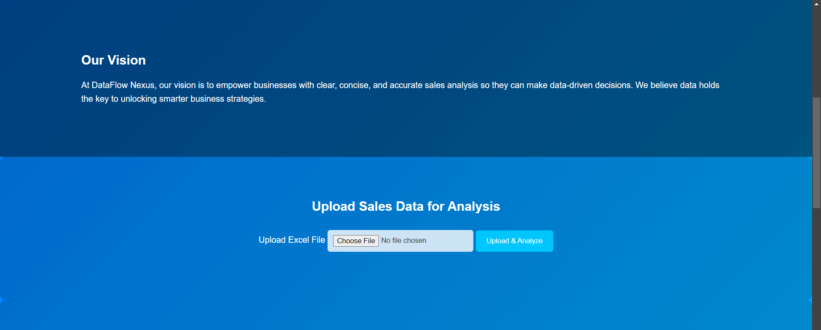
User Interface
The DataFlow Nexus Dashboard, where one can navigate between uploading data and results and meanwhile check what our company is all about – What we do and why choose DataFlow Nexus.
This section for – Uploading the Sales data for analysis

Slide 33
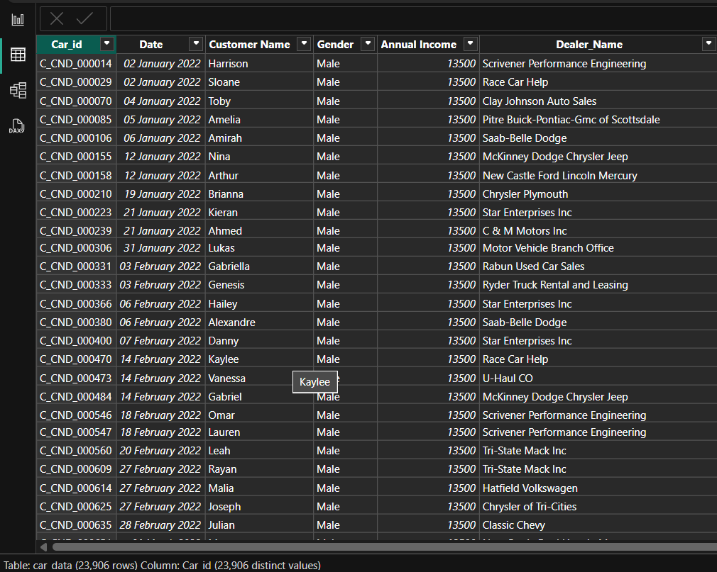
User Interface
PowerBi
Table: Car_data is used to analyse the data and give the required output
23906 rows and the Car_id having 23906 distinct values
The use of PowerBi is done in the backend for the analysis of the data and also for the cleaning of the data python libraries are used and the data is cleaned and checked for duplication and garbage and empty values

Slide 34
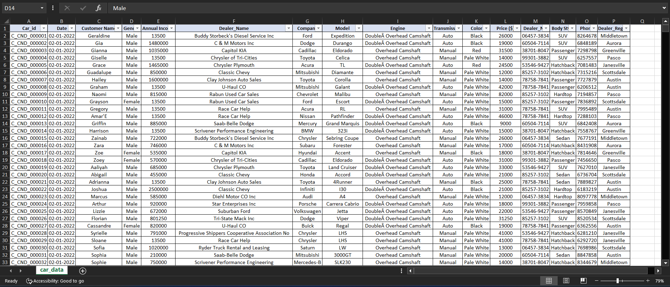
User Interface
Excel Sheet - Cleaned sales data

Slide 35
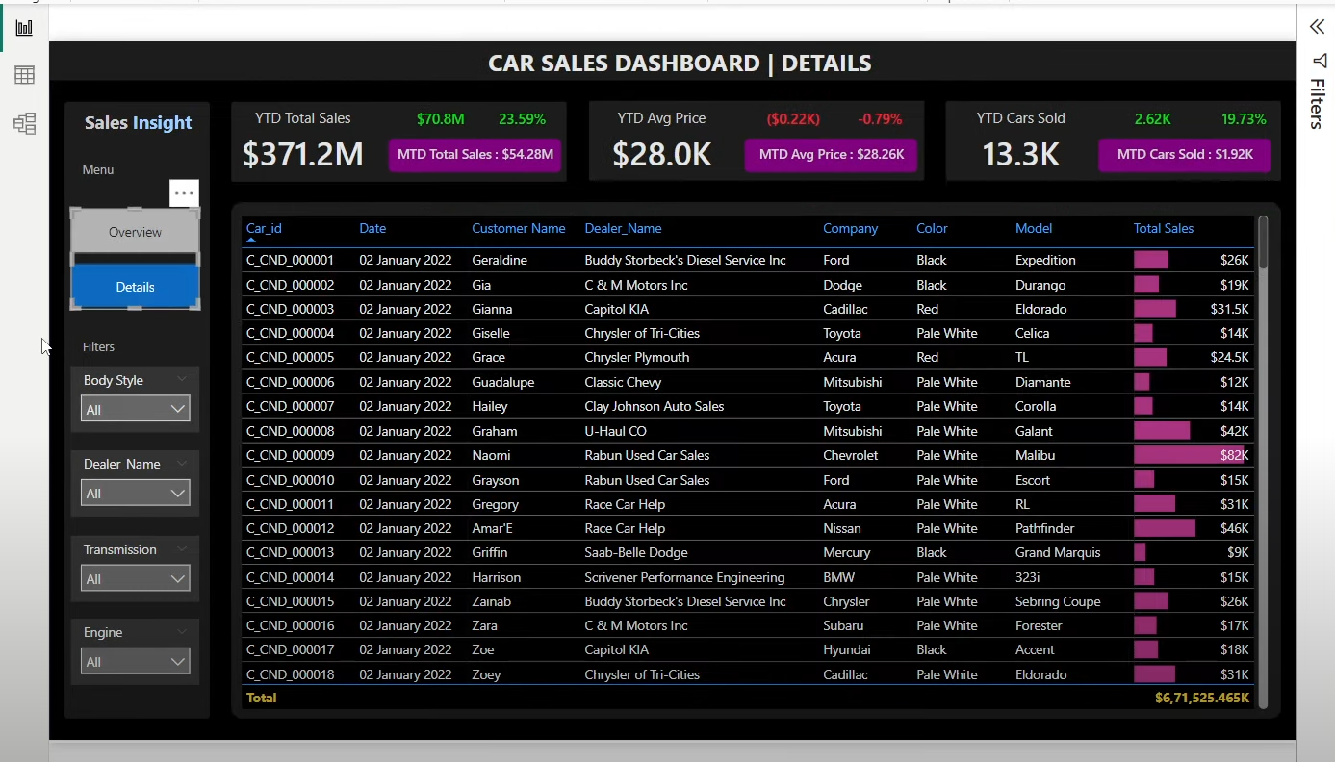
User Interface
PowerBi outputs - The details of the Car sales is shown and the total sales is shown in the form of a graph

Slide 36
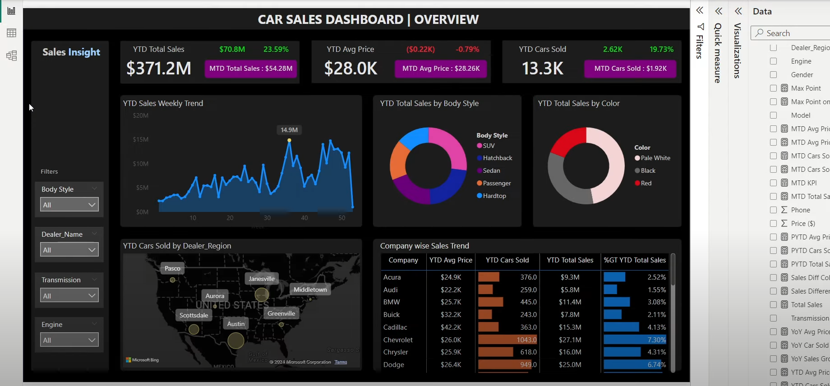
User Interface
PowerBi outputs - An overview of the Car sales is shown along with the regions in the globe too

Slide 37
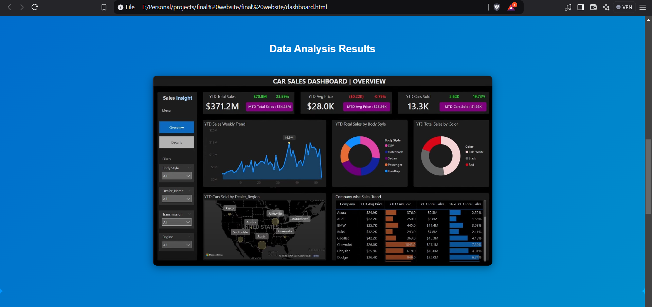
User Interface
The results on the website being posted for the user to access it later on after analysis.

Slide 38
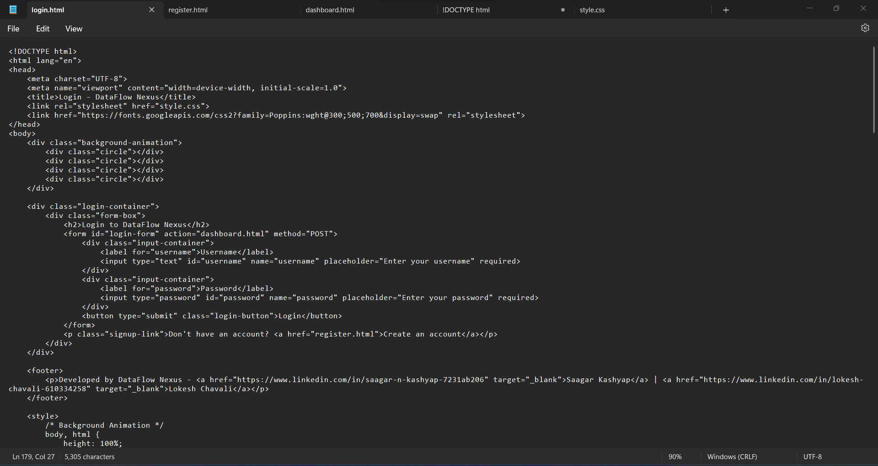
Code for login page

Slide 39
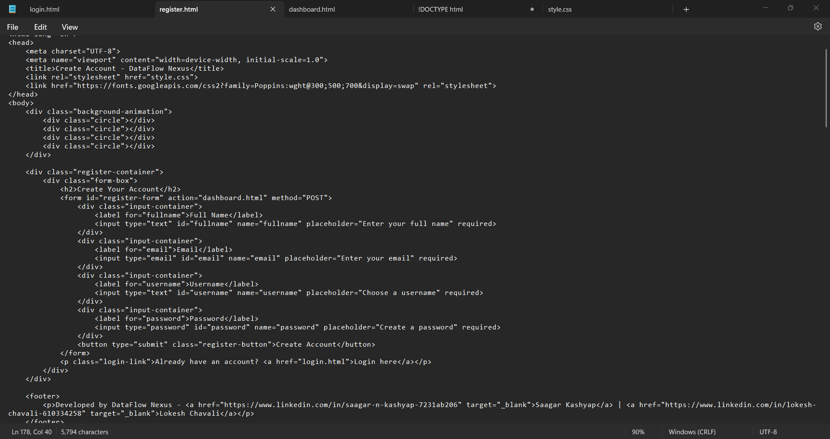
Code for registering a new user

Slide 40
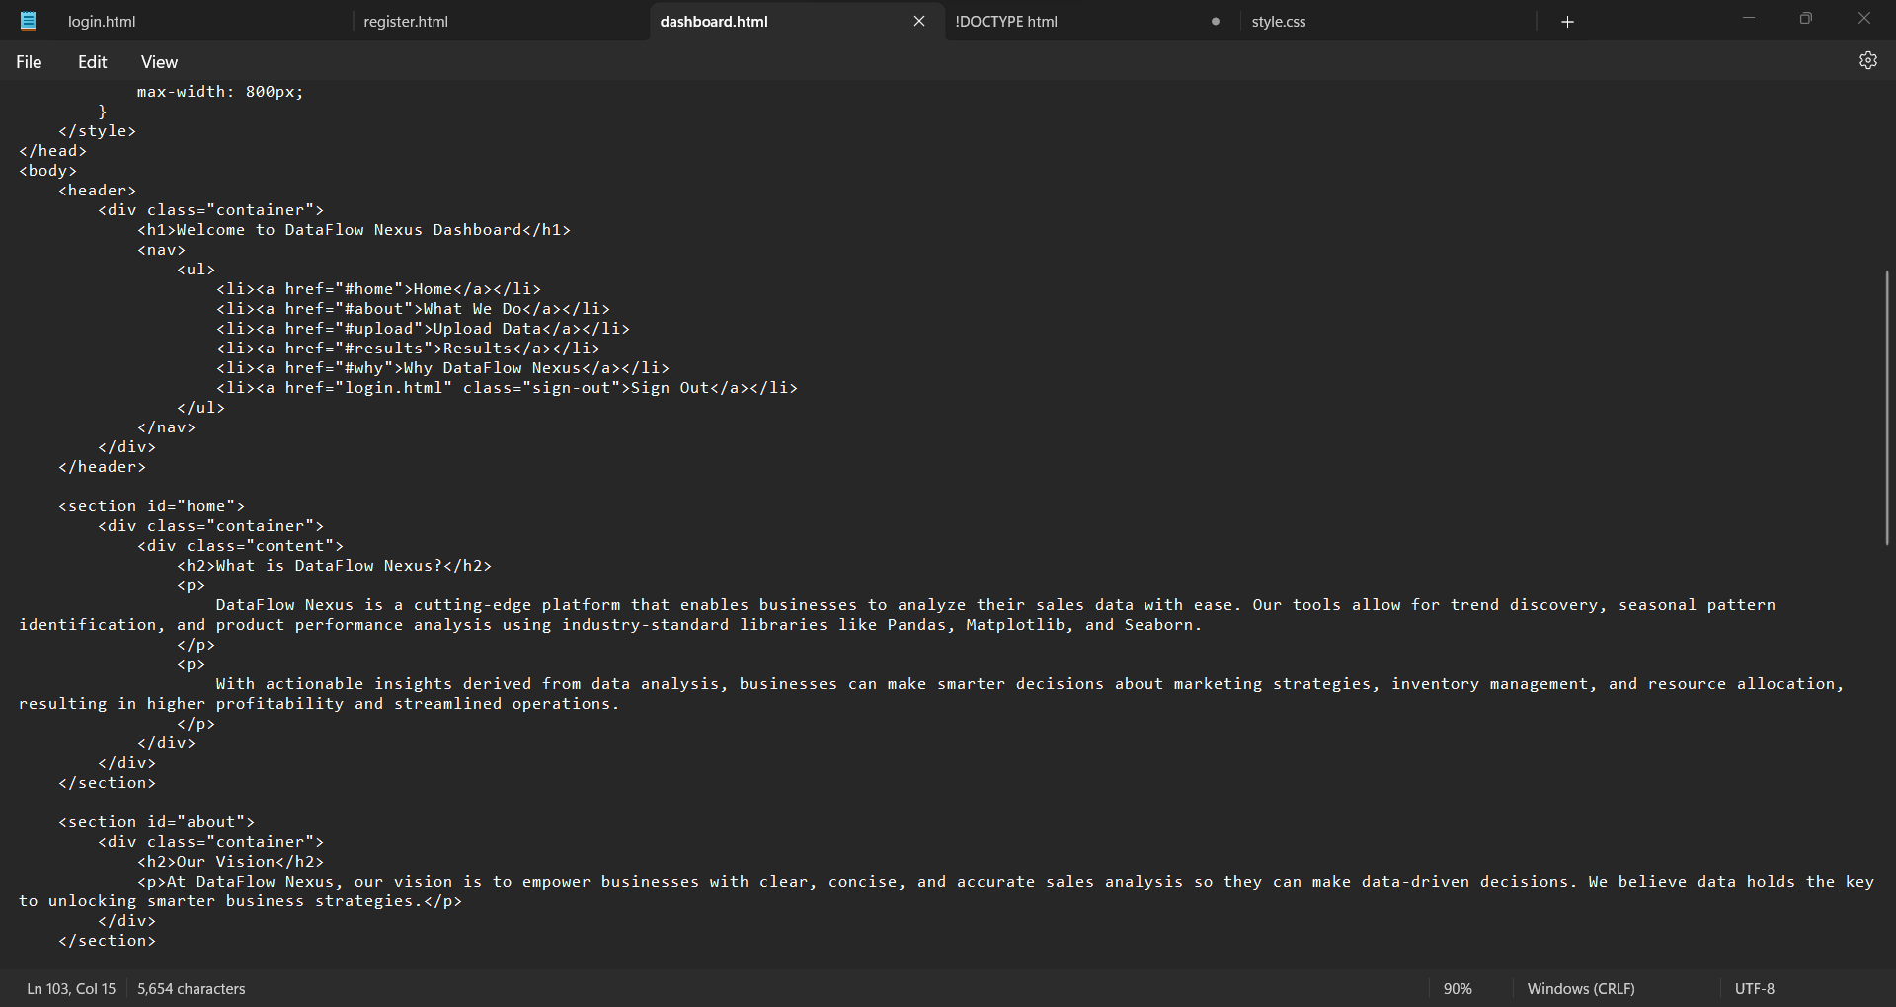
Code for the DataFlow Nexus Dashboard

Slide 41
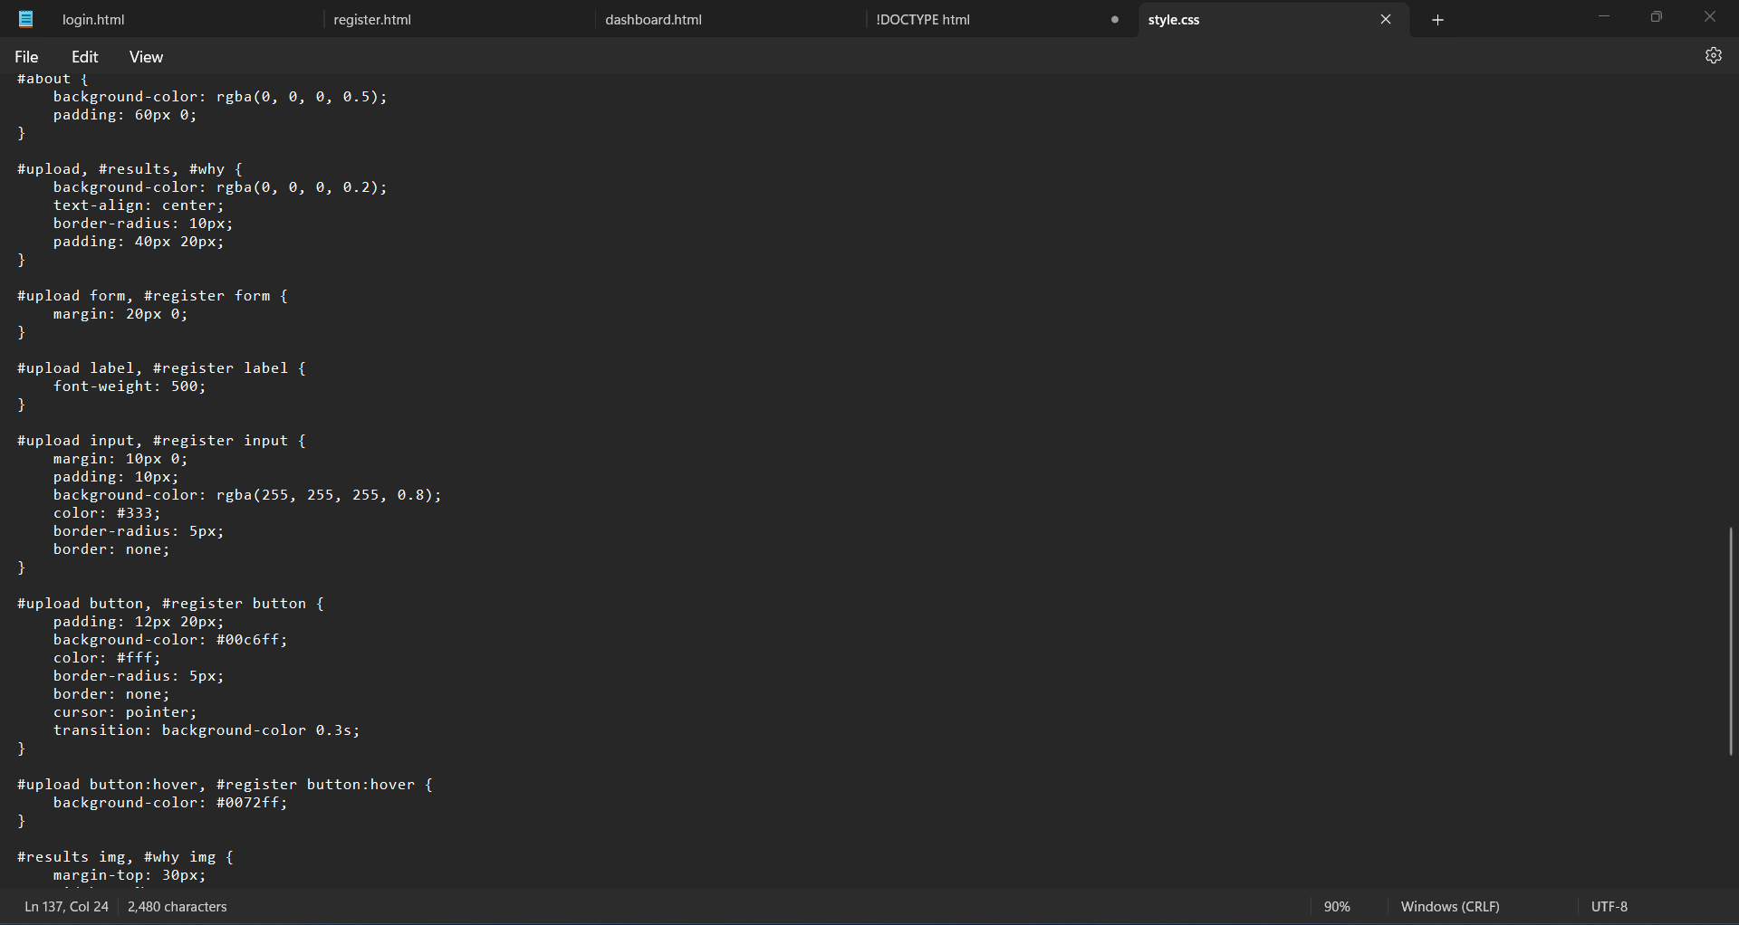
CSS Code for the styling of the website

Slide 42
Future Prospects
Automation and Scalability
Plans to implement advanced automation for faster, more accurate data processing, reducing dependency on manual operations. Scaling the system to handle larger datasets as the business grows.
Machine Learning Integration
Incorporating machine learning algorithms to predict future sales trends and customer preferences. Using predictive analytics to enhance marketing strategies and inventory management.
Real-Time Data Analysis
Transition to real-time data processing to allow instant decision-making. Implementing dashboards for dynamic, up-to-date data insights.
Cross-Platform Compatibility
Expanding access to data analysis results across multiple devices and platforms. Developing a mobile app for easier access to insights and reports on the go.

Slide 43
Bibliography
Sales Data - Sourced from Kaegal for a comprehensive dataset that includes information on sales trends, customer demographics, and product categories, providing insights for effective sales strategy development.
Data Cleaning Techniques - Followed best practices from GeeksforGeeks, including handling missing values, outliers, and data transformation methods to ensure data accuracy and improve model performance.
HTML, CSS, and Styling Tips - Referred to GeeksforGeeks articles for structuring and styling web pages, focusing on HTML5 and CSS3 for responsive design, accessibility, and enhancing the user interface and experience across devices.
Power BI for Data Visualization - Used Microsoft Power BI Documentation for creating effective visualizations, including bar charts, heat maps, and time series graphs, to analyze and present sales data in an engaging and informative way.
Python Libraries - Leveraged GeeksforGeeks and Python Documentation for using Pandas for data manipulation, Matplotlib and Seaborn for visualizing patterns and trends, and Scikit-learn for implementing machine learning models to predict future sales.

